Slide 1
Clocks of TIME
Day 3

Slide 2
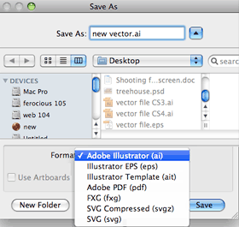
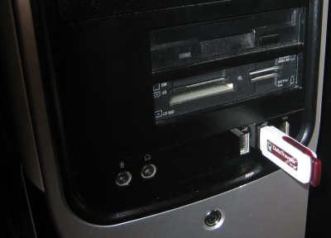
Laser Etcher Demo
Save “.ai” file onto a flash drive to plug into the computer hooked up to the laser etcher.

Slide 3
Open in Corel Draw
Change any vector lines that you want CUT THROUGH to hairline RED

Slide 4
Safety and Rules
Do NOT open machine while it is operating
Turn on the ventilation while it is operating
Don’t stare at the laser for too long because it can cause eye damage
Turn off laser when not in use
Watch the machine to make sure that it is operating correctly

Slide 5
Tutorial
If you ever forget or need to be reminded of your next step you can CAREFLLY READ this tutorial:
http://www.csufablab.org/wp-content/uploads/2013/09/Laser-step-by-step-tutorial.pdf

